Slide 1
Hakan Erol
Joji Asako
Trivi Tran
Soheil Karimi

Slide 2
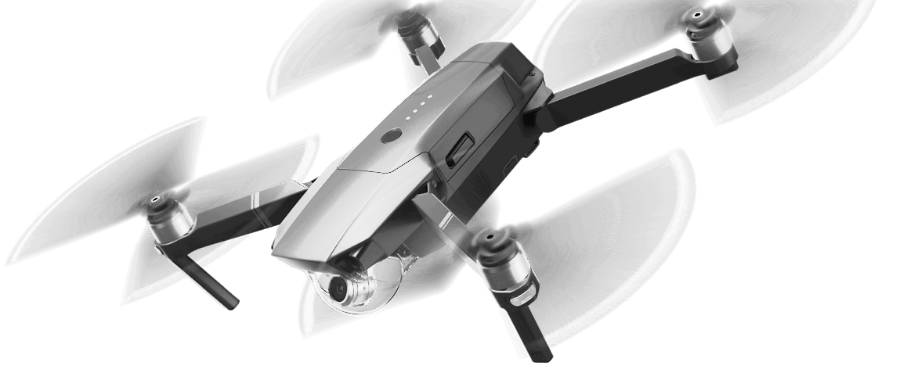
DRONE MOTION
fly with the force

Slide 3
Project Overview
Drone control using hand gestures
No sensors, only camera
Intuitive flying
Deep learning

